Slide 1
Hyper Protect Virtual Servers Wildfire Workshop IBM Hyper Protect Virtual Servers Introduction —
IBM Z & IBM LinuxONE / IBM Hyper Protect Virtual Servers / © 2020 IBM Corporation

Slide 2

Key goals and challenges of cloud adoption
Cost of setup and maintenance
Increased attack vector surface and risk of data breach
Downtime and other impacts to business or reputation
Difficulty maintaining compliance
Modernize workloads through containers
Integrate on and off prem environments
Embrace DevOps, microservice, etc.
Invest in existing infrastructure
Notes:
Modernize workloads through containers
Integrate on and off prem environments
Embrace DevOps, microservice, etc
Cost of setup and maintenance
Increased attack vector surface and risk of data breach
Downtime and other impacts to business or reputation
5.5 - https://ibm.northernlight.com/document.php?trans=view&docid=IA20190925050000180&datasource=IBM&context=BNES
As cloud deployments become more complex with multiple clouds and multiple types of clouds, the overall management from a security, compliance, integration, and cost perspective becomes increasingly difficult.
Containers becoming a key enabling piece of multi/hybrid cloud environments, making workloads more portable to meet customer, capacity and cost needs. Container and cloud management strategies converge as IT decision makers become convinced that containers and Kubernetes are the next major wave of cloud infrastructure.
GOALS
Across all industries, organizations are exploring Docker / Kubernetes container technology to enable their IT organizations to embrace agile development, micro-services, and DevOps practices.
Organizations want to more quickly build, integrate, and deploy container solutions to their hybrid and private clouds where they can leverage common tooling to manage all applications across their enterprise.
CHALLENGES
We see organizations starting to embrace cloud native development and cloud first technologies, wanting to embrace CICD pipelines, agile development, and devOps practices and leveraging fundamental technologies like Docker and Kubernetes to do that. SO with that movement in the industry, while that’s taking shape there are also the challenges seen in the market to secure data. There’s greater attack focus on business targets due to the high value of corporate assets and client data, so organizations are also challenged to harden their computing environments to better protect those assets and minimize risk due to vulnerabilities exploited by internal and external threats. No organization wants to be that company shown on the headlines with a data breach that they incurred.

Slide 3

Cloud Adoption: Security concerns & threats
62%
Data Privacy and Confidentiality¹
70%
Enterprises experienced an insider threat in the past 12 months²
Unauthorized access
Malicious insider threats
Malware
Human Error
A combination
What has made it more difficult to prevent?
Insiders already have access to the network and services
Increased use of applications that can leak data
Increased amount of data that leaves protected boundary
How can organizations adopt cloud while minimizing security risks?
Notes:
¹2019 Cloud Security Report https://www.isc2.org/-/media/ISC2/Landing-Pages/2019-Cloud-Security-Report-ISC2.ashx?la=en&hash=06133FF277FCCFF720FC8B96DF505CA66A7CE565
² https://www.cybersecurity-insiders.com/wp-content/uploads/2019/11/2020-Insider-Threat-Report-Gurucul.pdf

Slide 4





IBM Hyper Protect virtual servers
A secure virtualization platform that protects your critical Linux® applications during build, deployment, and management lifecycle phases on IBM Z® and LinuxONE
Build applications with integrity Leverage the secure image build process to sign images, validate code, and integrate into your CI/CD pipeline
Deploy workloads with trust Validate the provenance of your applications before deployment
Manage applications with simplicity Manage your infrastructure without visibility to sensitive code or data – RESTful API deployment
Encrypt & Sign critical solution components Give your images access to the industry leading FIPS 140-2 level 4 Hardware Security Module for signing and encryption needs
Notes:
IBM Hyper Protect Virtual Servers, protects Linux workloads on IBM Z and LinuxONE platforms throughout their lifecycle, build, management, and deployment phases. This solution delivers the security needed to protect mission-critical applications in hybrid multicloud deployments.
Hyper Protect Virtual Servers enables:
Developers to securely build their applications in a trusted environment with integrity
IT infrastructure providers to manage the servers and virtualized environment where the applications are deployed without having access to those applications or their sensitive data
Application users to validate that those securely built applications originate from a trusted source by integrating this validation into their own auditing processes
Chief Information Security Officers (CISOs) to be confident that their data is both protected and private from internal and external threats

Slide 5

Where it matters A Secure Infrastructure Foundation IBM Hyper Protect Virtual Servers serves as both a solution for external clients to securely build Docker based applications on IBM Z and LinuxONE and a foundational component of IBM solutions
Hyper Protect Digital Assets Platform
Enables custodians, exchanges, & Distributed Ledger Technology (DLT) ecosystem partners to protect tokenized assets and validate participants for transactions
Data Privacy Passports
Provides a secure host environment to deploy the Passport Controller used for policy enforcement and data transformation in Data Privacy Passports
Reduce Regulatory Compliance Scope
Host sensitive workloads that require a high degree of isolation and data protection to meet security & compliance needs for your organization, industry, or geography
FUTURE / ROADMAP: Enable clients to securely build their Platform as a Service, protecting critical containerized workloads from even cloud / k8s admins
Notes:
IBM Hyper Protect Virtual Servers, protects Linux workloads on IBM Z and LinuxONE platforms throughout their lifecycle, build, management, and deployment phases. This solution delivers the security needed to protect mission-critical applications in hybrid multicloud deployments.
IBM Hyper Protect Virtual Servers offering is designed to protect mission critical Linux workloads throughout their DevSecOps lifecycle. Hyper Protect Virtual Servers allow developers to leverage their modern application development skills while securely building their workloads in a trusted execution environment. Their solutions are signed, encrypted and deployed – all while administrators manage the infrastructure without access to the data.
Build applications with integrity
Leverage the secure image build process to sign images, validate code, and integrate into your CI/CD pipeline
Deploy workloads with trust
Validate the provenance of your applications before deployment
Manage applications with simplicity
Manage your infrastructure without visibility to sensitive code or data – RESTful API deployment
Encrypt & Sign critical solution components
Give your images access to the industry leading FIPS 140-2 level 4 Hardware Security Module for signing and encryption needs
Hyper Protect Virtual Servers enables:
Developers to securely build their applications in a trusted environment with integrity
IT infrastructure providers to manage the servers and virtualized environment where the applications are deployed without having access to those applications or their sensitive data
Application users to validate that those securely built applications originate from a trusted source by integrating this validation into their own auditing processes
Chief Information Security Officers (CISOs) to be confident that their data is both protected and private from internal and external threats
Not only does the IBM Hyper Protect Virtual Servers offering intend to server as a secure virtualized Linux environment for customer’s chosen workloads, it also intends to be used as the foundation for other IBM offerings.
The two target solutions to begin with are targeting the Digital Assets Platform and IBM Data Privacy Passports. Under evaluation is future integration with Red Hat OpenShift Container Platform.

Slide 6

Trading digital assets with trust and security: Phoenix Systems & KORE Technologies
Solution:
“It puts our clients’ minds at rest, as the moment they hear IBM, they know that their digital assets will be safe. And with the introduction of IBM Hyper Protect Virtual Servers, we get the benefit of containerization alongside end-to-end encryption of data.”
-- Isabella Brom COO at KORE Technologies
IBM LinuxONE
IBM Hyper Protect Virtual Servers
IBM Blockchain
Solution Value:
Boosts processing power eight-fold
End-to end-security via data encryption and isolation of customer environments
Simplifies compliance with regulatory policies
Seamless scaling and speed of delivery of new applications code via containerization
Check out the Video
Notes:
A key use case is Phoenix Systems, a company taking advantage of the new focus of the financial industry - tokenization of assets through blockchain solutions. To help realize the potential of this technology, KORE Technologies and Phoenix Systems are bringing transparency, control and security to the management of digital assets with their KORE platform. Built on IBM® LinuxONE technology, the platform offers companies enterprise-grade capabilities around the tokenization, management, trading and verification of digital assets. Dealing with sensitive data – security is an important factor in this company’s decision for a solution, and they wanted to deliver exceptional security to users of their platform via IBM Hyper Protect Virtual Servers. Combining automatic encryption of data both in flight and at rest with minimal administrator access, the solution protects digital assets from both internal and external threats.

Slide 7
Use Case: securing digital assets
A digital asset exchange wants to separate their signing module and private keys from their crypto exchange business module (used for buy / sell, match, Know Your Customer handling, etc.). The signing module and private keys are used in the process of signing Digital Ledger Technology i.e. DLT transactions
Web
Interface
Business Module
Hyper Protect
Virtual Servers
The Challenge | The organization aims to prevent bad actors from getting access to both the signing module and the private keys If a malicious actor gains access to the private keys, then he could get access all the assets on the exchange’s digital ledger – the coins!
The Solution | Deploy the signing module and private keys into IBM Hyper Protect Virtual Servers images running on IBM LinuxONE
The Outcome | Once separated, the exchange can now securely host and run their critical application container, which hosts the signing module, as well as a database hosting the user private keys The signing module and private keys are now protected and can only be accessed to execute a DLT transaction by the right credentialed user(s)
Application
Container
Signing Module 1
…
Secure Build Virtual Server Instance
Signing Module N
Database
Ex: 1 Million Private Keys (i.e. exchange user wallets)
Secure Build Virtual Server Instance
LinuxONE
Notes:
Here is an example of a customer that wants to leverage the IBM Hyper Protect Virtual Servers solution deployed on LinuxONE. This digital asset exchange is looking for the right platform to host the most critical components of their exchange platform: the signing module and the private keys used for committing Distributed Ledger Technology i.e. DLT transactions to their ledger.
To do this they want to separate their signing module application and users’ private keys from their business module which can reside on another platform, even public cloud linked via a web interface.
For the security of their business and assets, it is most critical to protect the signing modules and private keys; if you get the keys, then you have control of the assets, which in this case are the various coins hosted by the exchange.
The exchange moves to deploy their signing module and private keys as docker container images deployed as images on the Hyper Protect Virtual Server solution on their LinuxONE server. By deploying the signing modules and database, the exchange can gain sign those components via the secure build capability offered by the Hyper Protect Virtual Server solution and ensure that those modules and keys can only be deployed in this environment after their associated registration files are decrypted.
Ultimately, only the users with the right credentials to the access the signing modules and private keys can get access to their contents to execute the DLT transaction.

Slide 8




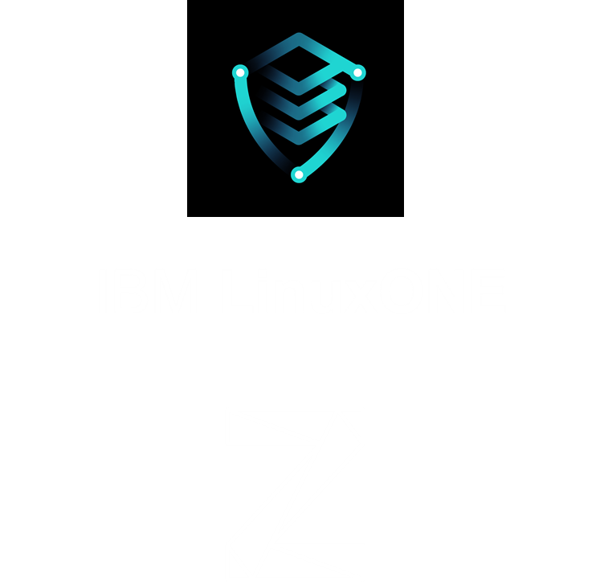
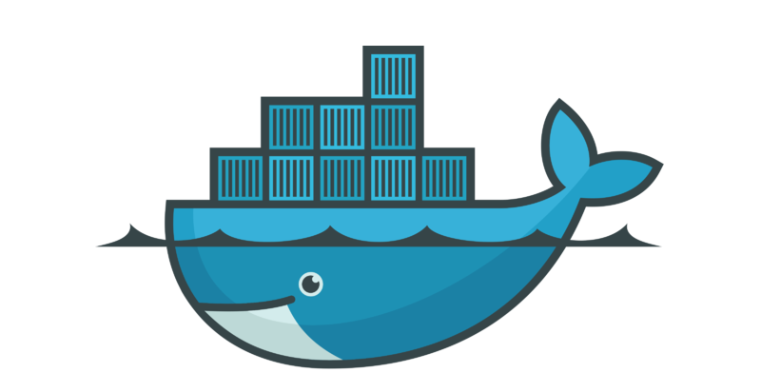
Trusted CI/CD stages: Bring your own image, sign, register, approve and deploy
Users and Actions
Application Developer
Auditor
Cloud Admin
Application User
Develop application image
Upload source files
Generate secure build
Perform security endorsement
Deployment (automated)
Offering and Interfaces
Image
Source code repository
Secure build
Manifest
Docker repository
Hyper Protect Virtual Servers
Other sources
Docker
image
Workload Lifecycle Phases
Code Development
Workload Build
Pre-Production
Production
Threat Vectors pose Potential Risks
Alter workload
Alter build environment
Modify workload deployment conditions
Secrets visible to admin
How Hyper Protect Virtual Servers COMBATS risks:
Sign application via secure build flow
Encrypt and register application configuration info
Validate image provenance via workload manifest
Decrypt application registration file – only possible via Secure Service Container (confidential computing environment)
Manage infrastructure via only RESTful interfaces
Notes:
At various stages, there are checks to ensure that certain individuals can not disrupt the process of building deploying or managing a given virtual server image. The flow starts with a developer writing code all the way over to what gets deployed and maintained in the infrastructure; looks at concept of guaranteeing integrity of image, inspect province of image so that before its deployed, its known what contents to expect with that image, and throughout process the principle of least privileged applies - only those who can see the application are the ones who should understand it. Likely not infrastructure or developers. Before that application is deployed, members in roles like auditor can review the manifest and check that the application’s contents are what’s expected. This conceptually can be built out further to starts to include multiple users the approval process (approval ceremony). Finally, once the application has been signed, combined with any secrets from a Secure Service Container encrypted / decrypted registration file, the contents check to ensure it’s what’s expected, the workload can be deployed.
A malicious person can replace an executable image in a repository with malicious code to have it deployed on an execution environment.
A secured run-time environment should be defined that only permits the download and installation of a properly signed/attested image.
A secured build pipeline should include a protected runtime environment (i.e. no data access from outside, no tampering) which protects the docker signing key.
A malicious developer of an application can embed malicious code in an executable image during a build process to have a malicious executable deployed on an execution environment.
A secured build pipeline should include an external or third-party attestation process whereby the provenance and security of the code can be assured.
A secured build environment that generates an executable image from multiple sources (e.g. code, libraries, middleware), a manifest that consists of the source programs, an endorsement of the image, and three public-private key pairs to sign the image, the manifest, and the endorsement.
The environment protects the three signing keys to prevent a third person from signing a malicious object with those keys to replace the original one.
The environment holds an endorsement policy that defines whether or not the image can be deployed and executed on a runtime environment.
The environment collects signatures from one or more auditors who verify the manifest with its public key, reviews the manifest, and attests the executable image with their signature.
The environment endorses the image when it collects signatures that meet the endorsement policy.
A runtime environment that deploys and executes an image only if the image and its endorsement are cryptographically assured with a corresponding signature from the build environment.

Slide 9






Hyper Protect virtual servers on-premises – Architecture
Push image source code from GitHub to Trusted CICD (i.e. Secure Build Server)
Export signed image to Trusted Code Repository (ex: Docker Content Trust)
Cloud Admin
Acquire then deploy image after its associated registration file is decrypted by appliance
App Developer or ISV
GitHub
Output resource metrics to Prometheus (based on open metrics standard)
App User
Crypto: Provides signed client workloads access to the HSM master keys for signing or encryption
Red Hat ® OpenShift ® Container Platform (RHOCP) [Future]
Run application deployed as a virtual server image
Command Line Interface (CLI) tool provides commands to control Hyper Protect VS offering components
(2) PUSH HA Metrics
To monitoring container
Virtual Server
Virtual Server
Virtual Server
Virtual Server
Virtual Server
Virtual Server
Linux on Z or z/VM ® Workloads
z/OS ® Workloads
Host Container
Monitoring
GREP11
Secure Build
App / Client Workloads
OCP Master Nodes
OCP Worker Nodes
x86 or s390x Machine
CLI
Registration Files
(1) Host Container FETCHES metrics from Hosting Appliance (HA)
REST
Trusted CICD
kernel
kernel
kernel
kernel
kernel
kernel
qemu
qemu
qemu
qemu
qemu
qemu
Monitoring
runc
runq
Virtual Servers
OpenShift (Future)
Docker Engine
Hosting Appliance
REST
Secure Service Container LPAR
Other LPARs
REST
App Dev / ISV
Cloud Admin
Output
LinuxONE II / LinuxONE III / z14® / z15™
z14 / z15
App User
Input
App Dev or Cloud Admin
Bi-directional

Slide 10
Resource Requirements
Knowledge Center - Technical Documentation:
https://www.ibm.com/support/knowledgecenter/SSHPMH
Hardware Requirements
Linux Management Server
IBM Z / LinuxONE (S390x architecture) or 64-bit x86
1 IFL on Z / LinuxONE or 4 or more x86 Linux cores (2.4 GHz)
16 GB RAM
256 GB Disk Space
Secure Service Container Partition – Supported Servers
IBM z15
IBM z14
IBM LinuxONE III
IBM LinuxONE Rockhopper II or IBM LinuxONE Emperor II
FC 0104 Container Hosting Foundation
Secure Service Container Partition – Min. HW Requirements (for 1 Hyper Protect VS container + 1 Secure Build container)
2 IFLs
12 GB RAM
190 GB Storage (50 GB Hosting Appliance, 100 GB for 1 Hyper Protect VS container, 40 GB for 1 Secure Build Container
Note: the full resources required on the Secure Service Container partition are heavily dependent on the workload deployed
Networking
1+ Open Systems Adapter (OSA)
Network between Linux Management Server and Secure Service Container partition or between multiple Secure Service Container partitions
2 Networks to create
Hyper Protect VS containers (internal IP addresses)
External request handling to services inside workload deployed in Hyper Protect VS containers
Network Interfaces
Ethernet (Layer 2, Layer 3)
VLAN (Layer 2, Layer 3)
Port Mapping
443: Hosting Appliance REST API
443: Secure Build server or BYOI with Macvlan
Any non-rserved port: Secure Build Server
8443: Monitoring infrastructure
9876: GREP11 container
Not Supported
Hipersockets
SMC-D
SMC-R (RoCE)
Crypto Hardware (optional - PKCS#11 over gRPC i.e. GREP11)
Trusted Key Entry (TKE) workstation
Crypto Express 7s
Crypto Express 6s
Notes:
NOTES
See the Secure Service Container User’s Guide for the latest firmware levels required for a given machine type and driver
BYOI = Bring Your Own Image

Slide 11
Resource Requirements Cont.
Software Requirements
Linux Management Server (Linux 64-bit)
Ubuntu 18.04 LTS
Ubuntu 16.04 LTS
Secure Service Container Partition
Ubuntu 18.04 LTS
Docker Versions
V19.03.2 or above (s390x architecture)
Note: Red Hat and SuSE operating systems are not supported in this initial release but will be evaluated for support in future releases.
Notes:
NOTES
(1) See the Secure Service Container User’s Guide for the latest firmware levels required
(2) Secure Service Container Partition – Min. HW Requirements requirements (1 Hyper Protect VS container + 1 Secure Build container)
(3) Regarding Secure Service Container partition minimum storage: 190 GB storage (50 GB hosting appliance, 100 GB in storage pool for one Hyper Protect Virtual Server container, and 40 GB for one Secure Build container)

Slide 12
Additional Information
Learn More | Start a Conversation | Show the Value | Show the Value
Content Solution Page Knowledge Center – Technical Docs IBM Z Community - Validated Open Source on Z / LinuxONE IBM Hyper Protect Services Redbook | Contact Offering Manager: for Additional Help Diana Henderson, dmhender@us.ibm.com | Offering Announcement Hyper Protect Virtual Servers Webpage Secure Service Container Video IBM Systems Magazine Article | Overview Beta Video Competitive Comparison (Coming Soon) Code Pattern (Coming Soon) IBM Cloud Blog – Hyper Protect Virtual Servers as differentiator
Digital Assets | Offer Trial or POC | Pricing Information | Pricing Information
Digital Asset Custody Services (DACS) IBM Video IBM Blog Coindesk Article Blockonomi Article Crowdfund Insider Article Phoenix Systems: IBM Video IBM Case Study | Contact Offering Manager: Diana Henderson, dmhender@us.ibm.com | Order IBM Hyper Protect Virtual Servers via Software Quote and Order i.e. SQO w3 OneTEAM access approval is required first Request Access > By Application Name > enter “SQO > select “DSW Online / Software Quote and Order (SQO)” > follow instructions | T-shirt sizes to match popular cloud consumption models for Virtual Servers *Pricing Details in Backup
 | Need Help?
 | Diana Henderson Offering Manager, IBM Hyper Protect Virtual Servers dmhender@us.ibm.com Anbazhagan Mani (goes by Anbu or Mani) STSM & Master Inventor, Private Cloud Architect, IBM Z and LinuxONE manbazha@in.ibm.com |  | Slack: #ask-hyper-protect WW LinuxONE workspace
Notes:
This is a reference slide of the resources to learn more about IBM Hyper Protect Virtual Servers
SQO = Software Quote and Order

Slide 13
Demos
Objective:
Build, Develop, Deploy a ‘hello-world’ service
The Cloud Administrator completes install and setup of Hyper Protect Virtual Servers on-Premise Infrastructure
The solution developer develops code in GitHub, builds application image
The cloud administrator securely deploys the application image as a Virtual Server Instance

Slide 14

Developers: Setup
SETUP
BUILD
REGISTER
MANAGE: ERROR HANDLING
Overview
Methodology enabling developers to securely build source files (starting from docker or non-docker applications)
Who’s Involved
Cloud administrator
What you Need
Source files, everything to build application
Access to Hyper Protect Virtual Servers appliance
What’s Provided
Command Line Interface tool to deploy
Output
Extracts HPVS package
Install Hyper Protect Virtual Servers CLI on the Linux Management Server
Start running Hyper Protect VS Commands
Value
Easily install and setup the infrastructure for Hyper Protect Virtual Servers

Slide 15
Developers: Secure Build
SETUP
BUILD
REGISTER
MANAGE: ERROR HANDLING
Overview
Methodology enabling developers to securely build source files (starting from docker or non-docker applications)
Who’s Involved
Solution Developers who want to securely build applications
What you Need
Source files, everything to build application
Access to Hyper Protect Virtual Servers appliance
What’s Provided
Secure Build container, public/private key pair generation
Output
Docker Image (signed) – only deployable via signed registration file
Manifest (signed) – enables application end user to verify the provenance of image from secure build
Public/private key pairs
Value
Provides solution developers with image integrity to know it only contains what’s intended and enables end users to have confidence in the origin of the application they’re deploying

Slide 16
Developers: Registration
SETUP
BUILD
REGISTER
MANAGE: ERROR HANDLING
Overview
Restrict access to application secrets
Who’s Involved
Solution Developers – don’t need production secrets
Infrastructure providers - don’t need access to app secrets
What you Need
Trusted CICD protected application
Any application secrets, configuration information
What’s Provided
Public key for signing and encryption of repository registration files
Output
Repository Registration File (Signed & Encrypted) – includes applications secrets that are encrypted and can be bound to the application image, its docker repository, and made available to end users’ instance of Hyper Protect Virtual Server at runtime (not deploy time)
Value
Ensures that confidentiality of application is protected

Slide 17
Cloud Administrator Error Handling
SETUP
BUILD
REGISTER
MANAGE: ERROR HANDLING
Overview
Review errors presented in solution
Who’s Involved
Infrastructure Providers
Solution admins and users
What you need
IBM Z or LinuxONE server
What’s Provided
Hyper Protect Virtual Server Appliance
Value
Navigate through the errors produced by the solution to debug any issues

Slide 18
Thank you

Slide 19
Glossary
HPVS- Hyper Protect Virtual Servers | Secure containerized docker image instances able to interact with other cloud services
SBS - Secure Build Service | The process of building the application code from a Git-like source repository into a container image for s390x architecture, signing the image by using the authentication keys, and publishing the image to the remote repository for later integration
BYOI - Bring Your Own Image | part of IBM Hyper Protect Virtual Servers solution to support the development and deployment of your own container images on top of the Secure Service Container framework.
CLI - Command Line Interface | Command Line Interface to manage Hyper Protect Virtual Servers
OCP – Openshift Container Platform | Container Application platform based on based on kubernetes container Orchestrator for application development and deployment
SSC - Secure Service Container | A container framework based on the runq technology, that is supported by the IBM Z or LinuxONE servers.
HA - Hosting Appliance | A component within IBM Secure Service Container based appliances, providing the enablement for running Docker-based workloads.
RunQ | An open-sourced hypervisor-based Docker runtime environment, which is based on runc to run regular containerized images in a lightweight KVM or Qemu virtual machine.
Registry - Docker Registry | A Registry is a hosted service containing repositories of container images that responds to the Registry API. For example, Docker Hub.
Repository - Docker Repository | A repository is a set of containerized images. A repository can be shared by pushing it to a registry server. Different images in the repository can be labeled using tags. For example, hpvsop-base.
Repository Registration File | An encrypted registration file used to register the repository, for authentication or validation reasons, such that a Hosting Appliance will trust that the image, when pulled from the registry, is authentic.
OCI - Open Container Initiative | Open standard for OS level virtualization such as containers

Slide 20
IBM sign-off

